Slide 1
Design Patterns
Review of the Principles

Slide 2
OO Design 101
Look for nouns
  Good candidates for classes/objects
Then, what are these objects responsible for?
  Good candidates for methods
Then, look for relationships among types of objects
  Is-a, Has-a, Uses, etc.

Slide 3
Beginner’s Principle: DRY
Consequences of not following it:
  Repeating bugs
  Code bloat
  Repeating changes (and sometimes you miss some changes)

Slide 4
DRY Downsides
We don’t always do it – why?
Requires extra design/implementation time
  Maybe not worth it
  Faster to just copy and paste
Code segments are small
  Duplication may be incidental
Duplication is in unrelated modules
  Increases coupling

Slide 5
Design Tools for DRY Code:
Functions
Objects
Inheritance
Patterns: which ones?

Slide 6
The Role of Inheritance
Key use is for Is-a relationships
  Refining types into subtypes
Has the side benefit of code sharing
  AND Concept sharing
  But this can be abused
Inheritance is overused or misused by novices
  Been there, done that, got the T-shirt, wore it out

Slide 7
Inheritance is not The Answer
Not everything we’ve put in the Duck class should be inherited
  Some ducks don’t fly, etc.
Inheritance is specified statically (before runtime)
  It is too rigid to easily accommodate change like this
  We must change code

Slide 8
Design Principle
“Identify the aspects of your application that vary and separate them from what stays the same.”
You decide what varies and what doesn’t
  Not cast in stone (humans still required!)
This principle underlies most patterns

Slide 9
If you don’t Separate…
Code is harder to understand
Files get modified for many purposes
Changes can affect users incidentally

Slide 10
Proverb
“All problems can be solved by adding another level of indirection”
In other words, create a new class to encapsulate what is needed
  Then glue it in appropriately

Slide 11
The PIMPL Idiom
Pointer to Implementation
  One way of implementing the indirection proverb
Why do we do it?
  Mainly because the implementation may change!
  So we are encapsulating something that varies

Slide 12
Commonality/Variability Analysis
You already understand this in part
  Polymorphism via virtual functions separates what changes (the implementation) from what stays the same (the interface)
But there are other ways to provide the needed separation
  Subtype polymorphism is only one narrow manifestation of this principle
  Finding just the right composition is as much art as science
    In other words, humans are still required

Slide 13
Separating What Varies
Let’s see what happens is we encapsulate Flying and Quacking behaviors in their own classes
In other words, the implementations of these behaviors go into their own respective hierarchies
  There still needs to be something in Duck that ultimately invokes these behaviors, of course
  That is, the interface is still there

Slide 14
Design Principle
“Program to an interface, not an implementation”
How:
  Inheritance (implementing an interface)
  PIMPL
  Adaptor
  Façade

Slide 15
Design Principle
“Favor Composition over Inheritance”
Of course, we used inheritance
  But not for everything
  Only when we needed an “is-a” or “implements” relationship
Composition is more flexible
  Resist the urge to over-classify via hierarchies

Slide 16
Why is Composition Better?
Increased runtime flexibility
Makes it easier to separate interface from implementation (see PIMPL)
Maybe easier to maintain

Slide 17
Composition vs. Inheritance
Remember Is-A and Has-A (and Uses-A)!
They are the first guides for design of Inheritance and Composition
Further design, including patterns, can refine the relationships

Slide 18
Cohesion
What is cohesion?
How does composition affect cohesion?
It should improve it:
  We are removing non-germane data/behavior into a separate class(/hierarchy)
Of course, it can be overdone

Slide 19
Principle: SRP
Single Responsibility Principle
What does it mean?
  A class (or function) has only one job it is to do
  Book: a class should have only one reason to change
  So a class should have only one method?
  But Ducks fly and quack! Isn’t that two responsibilities?

Slide 20
SRP
Consequences of not following it/symptoms:
  Large classes/methods/functions
  Lots of conditionals (high McCabe complexity metric) – Hard to understand
  Unrelated conditionals: increased maintenance activity
  Large parameter lists (symptom)
Remedies:
  Patterns: Strategy, State, etc.
  Split classes/functions/methods

Slide 21
Pattern Truths
“Patterns guide humans, not machines”
  Hence not connected to code generation or other automated tools
  Cannot replace programmers!
Patterns will not turn programmers into experts
  Unless they use them over time and absorb the underlying principles

Slide 22
The Open-Closed Principle
Classes should be open for extension but closed for modification
It is better to extend a class by not changing its code
  Clients dependent on it will have to change
  New bugs can emerge
  We have seen how inheritance often violates this principle
  But there are other ways to extend classes!
    Composing a wrapper, for instance

Slide 23
OCP
Consequences:
  Always have to change the base class: harder to maintain.
  Changes may cause clients to change
Approaches:
  Decorator; also Adaptor
  Redesign class hierarchy
  Follow the Dependency Inversion Principle
  Separate Interface from Implementation

Slide 24
The Decorator Pattern
Structural
Intent:
  Add additional responsibilities to an object dynamically.
Context:
  Applies when clients program to an abstraction (not its subtypes). A decorator can be used in the same way as its subject (“is-a”). The set of additional responsibilities can be open-ended. Existing subject code does not change. Multiple decorators can be combined sequentially.
Solution:
  The Decorator implements the same interface as the abstraction. It manages a concrete instance of the abstraction via composition, and adds additional functionality. It calls the managed object’s methods and combines the result with the additional functionality.

Slide 25
The Law of Demeter
Don’t talk to strangers
Avoid transitive coupling
  Why?

Slide 26
Law of Demeter: Implications
If you follow it, what does it imply about your object design?
Each object must provide a complete interface – it can’t delegate part of its interface to objects it contains
But this can result in fat interfaces – what can you do to reduce this problem?

Slide 27
Principle: LSP
Liskov Substitution Principle
What does it mean?
  An instance of a derived class can be used wherever an instance of the base class is used

Slide 28
LSP: Implications
What does it mean about the base class-derived class relationship?
  Base classes define an interface, and may define behavior
  Derived classes must fulfill the interface, and may extend the behavior
    Not recommended to override base class behavior (e.g. negative ploymorphism)

Slide 29
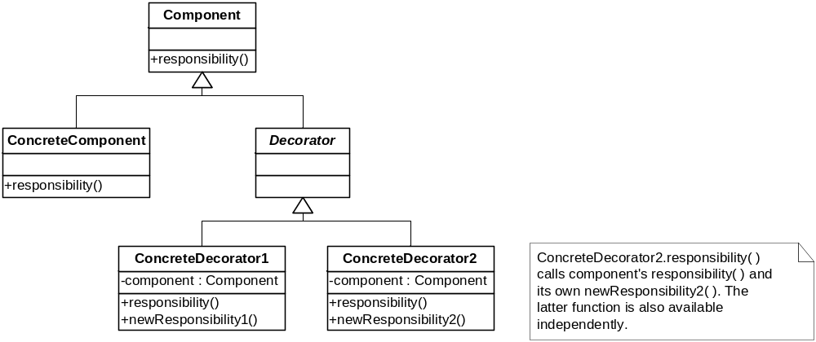
Decorator, Again (LSP)
⬅ Sometimes optional

Slide 30
LSP, Parting Shot
It’s also intent:
  An interface defined in the base class implies some behavior
    E.g., a method named input() implies input of data
  A derived class’s implementation of the interface must honor the intent
    Even though it is physically possible to do something different
  Obvious, I hope ☺

Slide 31
Dependency Inversion Principle
General form:
  Concrete items may depend on abstract items, but abstract items should not depend on concrete items
As usually applied to OO Design:
  A base class should not depend on any of its derived classes

Slide 32
DIP Violation Warning Signs
Casts down the inheritance hierarchy
Checks for object type
  No, using your own type tag doesn’t make the problem go away
Yes, sometimes you have to do them (rarely!)
  Avoid if you can

Slide 33
Code Smells
(Principle Violation Warnings)
Duplicated Code
Long Method
Large Class
  Many data members and/or methods
  Prime breeding ground for duplicated code
  Or may have cohesion problems
Long Parameter List
  Hard to understand; easy to get wrong

Slide 34
Divergent change
  Changes to a class or method that are for different reasons; pull it in different directions
  (Cohesion is on life support)
Shotgun Surgery
  The “opposite” of Divergent change
  A single change causes many small changes across multiple classes
  (Coupling is alive and well)

Slide 35
Data Clumps
  Groups of data that like to hang out together
  (There’s a reason they hang out together)
Primitive Obsession
  Lots of variables of primitive types
  Not getting the benefit of objects
Switch Statements
Parallel Inheritance Hierarchies

